Slide 1
DevSecOps: A New Value-Added Approach to Security
By Esmond Burke

Slide 2
Agenda
Definition of DevSecOps
Benefits of DevSecOps
The New Approach
Team size and composition
Cost estimate
Team interactions

Slide 3
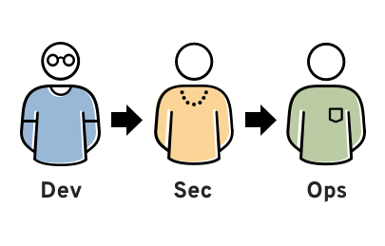
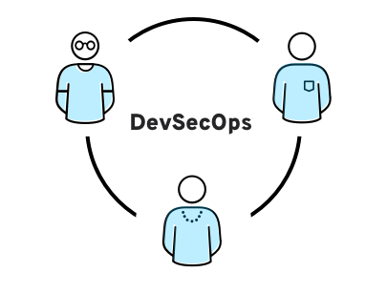
Definition of DevSecOps
DevSecOps is a development framework that integrates security into the development and operations lifecycle. It is a collaborative approach that brings together developers, security engineers, and operations engineers to work together to build secure software.
It's an approach to culture, automation, and platform design that integrates security as a shared responsibility throughout the entire IT lifecycle(VMWare).
Old Traditional Approach
Agile Approach
Image by Red Hat

Slide 4
Benefits of DevSecOps
There are cost savings and increased revenue using DevSecOps model.
Reduced security risks: DevSecOps helps to reduce security risks by embedding security into the development process. This helps to identify and mitigate security vulnerabilities early in the development lifecycle, when they are easier and less expensive to fix saving in cost delays and future downtime/fines due to breaches.
Increased speed to market: DevSecOps can help to increase speed to market by reducing the time it takes to develop and deploy secure software. This is because security is not treated as an afterthought, but rather as an integral part of the development process. Increase in speed to market means a realization of revenue earlier.
Improved quality: DevSecOps can help to improve the quality of software by ensuring that security is considered throughout the development process. This can help to prevent security vulnerabilities from being introduced into software, and can also help to improve the overall quality of the software. Improved quality means reducing maintenance cost and improved customer experience increasing revenue due to customer retention.

Slide 5
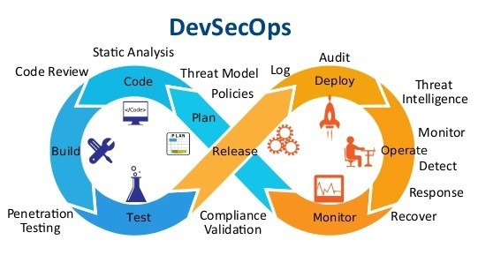
The New Approach
Image by DevOpsSchool

Slide 6
Team Size and Composition
The size of the DevSecOps team will vary depending on the size and complexity of the organization. However, a typical DevSecOps team for our toll authority will include 6-10 people. We need to keep the team small to allow for agile meetings and events. Small team will focus on deliver regular releases every 2-3 weeks:
Developers - 1 or 2 people
Security engineers - 1 or 2 people
Operations engineers - 1 or 2 people
Project manager - 1 person
Business analyst - 1 person
Software architect - 1 person

Slide 7
Cost Estimate
The cost of implementing DevSecOps will vary depending on the size and complexity of the organization. However, a typical cost estimate for a DevSecOps team would include (annual budget):
Team member salaries : $1.05 million (Job Search - Millions of Jobs Hiring Near You | ZipRecruiter, n.d.)
Tools and software : $48,000 (Pickard, 2022)
Training : $4000 (Infosec, 2023)
Infrastructure (local and cloud): $16000 (Pricing—Microsoft Defender | Microsoft Azure, n.d.)

Slide 8
Team Interactions
The DevSecOps team will interact with a variety of other teams within the organization, including:
IT audit and security: Granular reporting about security of builds
Finance: Explaining cost of DevSecOps Tools
Legal: Collaboration on software licensing (open or proprietary)
IT Software Development: Software development can have more than 1 team
Operations: Ensure functionality of builds
Business units: Increased visibility across the business.

Slide 9
Conclusion
DevSecOps is a new approach to security that can help organizations to reduce security risks, increase speed to market, and improve the quality of software. By embedding security into the development and operations lifecycle, DevSecOps can help organizations to build secure software more quickly and efficiently.

Slide 10
Call to Action
I encourage you to consider implementing DevSecOps in your organization. DevSecOps is a proven way to improve security, speed, and quality.
?

Slide 11
References
Infosec. (2023, March 29). DevSecOps - Infosec. https://www.infosecinstitute.com/skills/learning-paths/devsecops/
Job Search - Millions of Jobs Hiring Near You | ZipRecruiter. (n.d.). ZipRecruiter. https://www.ziprecruiter.com/
Kumar, A. (2021, November 5). What is DevSecOps? Benefits of Adopting DevSecOps: - DevOpsSchool.com. DevOpsSchool.com. https://www.devopsschool.com/blog/what-is-devsecops-benefits-of-adopting-devsecops/
Pickard, S. (2022, October 4). 10 Best DevSecOps Tools for 2023 - with Free Trials! PC & Network Downloads - PCWDLD.com. https://www.pcwdld.com/best-devsecops-tools#wbounce-modal
Pricing—Microsoft Defender | Microsoft Azure. (n.d.). Microsoft Azure. https://azure.microsoft.com/en-us/pricing/details/defender-for-cloud/
What is DevSecOps? (n.d.). https://www.redhat.com/en/topics/devops/what-is-devsecops

